Slide 1
Trending Topics in ITC Litigation
Presented by: Sheila Swaroop & Jonathan Bachand
May 1, 2024
The content of this presentation is for educational purposes only and does not necessarily reflect the opinions of Knobbe Martens or its clients.

Slide 2
Trending Topics
Recent Trends in Section 337 Litigation
Legislative Reform
First Use of the ITC’s “Interim ID” Program
Domestic Industry Update
Public Interest Update
Use of the ITC for Claims Other Than Patent Infringement

Slide 3
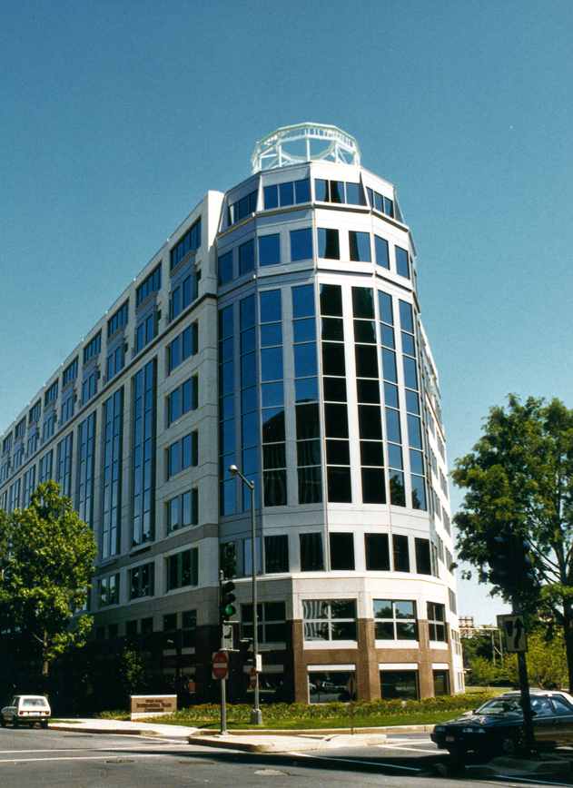
ITC Overview
Administrative agency in Washington D.C.
Six Commissioners – currently four
Administrative Law Judges – currently six
Office of Unfair Import Investigations
Responsible for administration of U.S. trade laws, including Section 337
Section 337 provides mechanism to prevent the unlawful importation into the United States of articles
Available remedies:
Exclusion order to prevent the importation of articles into the United States
Cease-and-desist order directed to U.S. companies to prevent sales of articles that have already entered

Slide 4
Recent Trends in Section 337 Litigation
FY2023 and FY 2024 filings
Most common technology areas are computer and telecommunications products and consumer electronics
Declining rates of settlement
Average length of investigations ranges from 17-19 months over the past five years
Section 337 Statistics | United States International Trade Commission (usitc.gov)

Slide 5
Recent Efforts at Legislative Reform
Advancing America’s Interest Act
Key provisions proposed
Changes proof requirements for domestic industry when relying on licensing activities
Requires affirmative determination that exclusion is in the public interest
Requires ITC to identify any dispositive issues for 100-day determination

Slide 6
Use of the Interim ID Program
IID “pilot program” started May 2021
Allows litigants to ask for early resolution on a potentially case-dispositive or case-limiting issue
Domestic industry
Standing
Infringement and invalidity (including 101)
Pilot program requests are not frequently made or granted
First Use
In re Certain Replacement Automotive Lamps 1 & II, 337-TA-1291, 1292

Slide 7
Domestic Industry Update
Analysis of “aggregated” domestic expenditures in 337-TA-1292 and 337-TA-1291
Patentees each asserted 20 design patents directly to lamps for automobiles
Patentees attempted to aggregate investments for different domestic products that practiced different patents, instead of doing this analysis on a patent-by-patent basis
Commission found that this approach failed to establish economic prong of domestic industry

Slide 8
Public Interest Update
Philip Morris v. ITC, 63 F.4th 1328 (Fed. Cir. 2023)
Discusses the scope of the Commission’s obligations to consult with federal agencies when issuing exclusion orders
Commission publishes Federal Register notices, accepts submissions from agencies, and considers evidence presented by the litigants

Slide 9
Non-Patent Claims Raised in Section 337 Investigations
trademark infringement
trade secret misappropriation
trade dress infringement
copyright infringement
unfair competition
false advertising
antitrust
price fixing
tortious interference
DMCA

Slide 10
Sheila Swaroop
Sheila.Swaroop@knobbe.com
Jonathan Bachand
Jonathan.Bachand@knobbe.com

