Slide 1
Advanced Strategies for
PTAB Practice:
Focus on Petitioners
October 12, 2023
Ben Anger and Brandon Smith

Slide 2
Agenda
Part 1 – Ben Anger
Selecting Your Grounds: Anticipation versus Obviousness
Addressing Non-Analogous Art Arguments
Part 2 – Brandon Smith
Claim Construction Issues With Prior and Parallel Proceedings

Slide 3
Selecting Grounds for the Petition
A common scenario for petitioners
Developing petition grounds
Locate a strong primary reference
It meets all the claim limitations
Consider grounds based on anticipation
But have concerns about potential vulnerabilities
May need to pull from different embodiments
Reference uses different terminology than the challenged claims

Slide 4
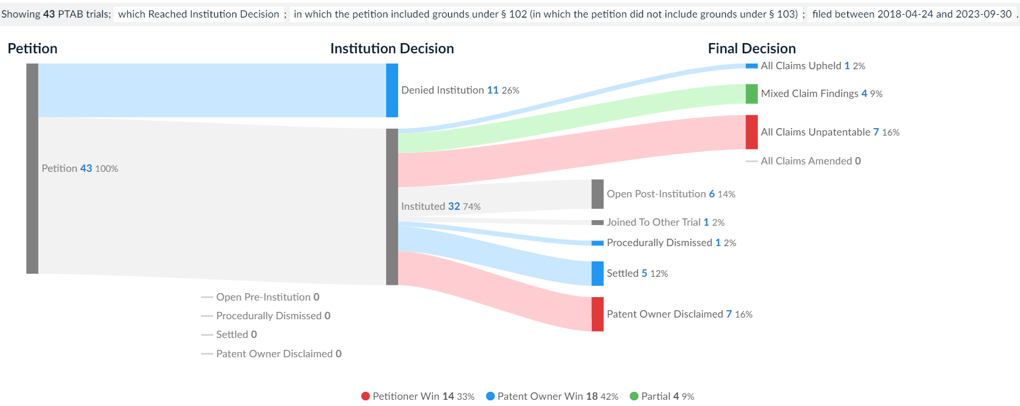
Selecting Grounds for the Petition
Petitions including only § 102 grounds: 43 petitions
Criteria:
Post-SAS filing date
Reached Institution Decision
Includes only 102 grounds
Source: Lex Machina

Slide 5
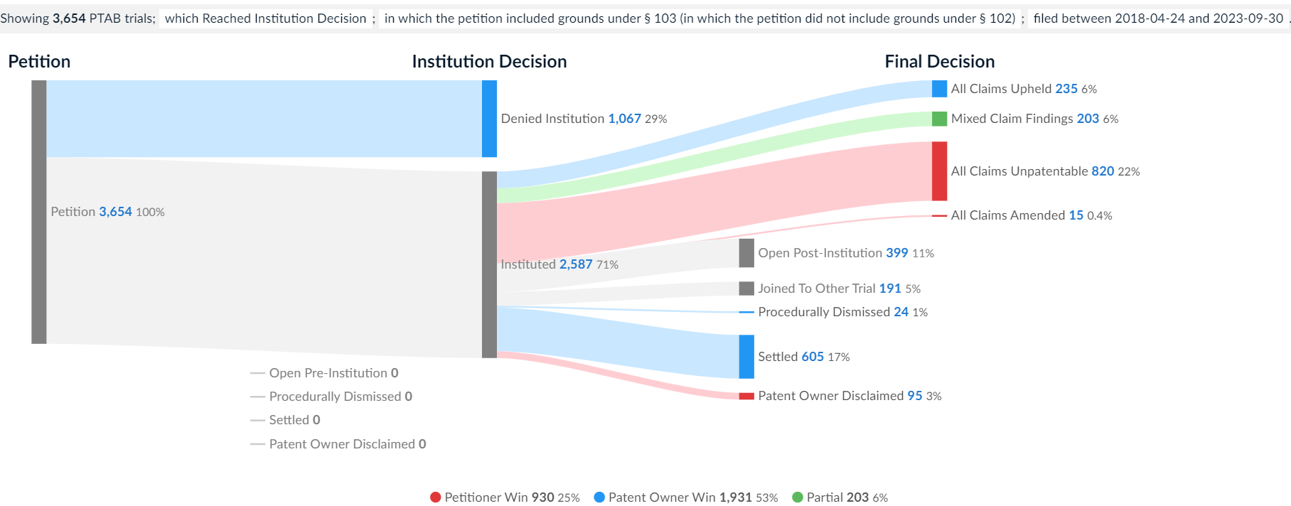
Selecting Grounds for the Petition
Petitions including only § 103 grounds: 3,654 petitions
Criteria:
Post-SAS filing date
Reached institution Decision
Includes only 103 grounds
Source: Lex Machina

Slide 6
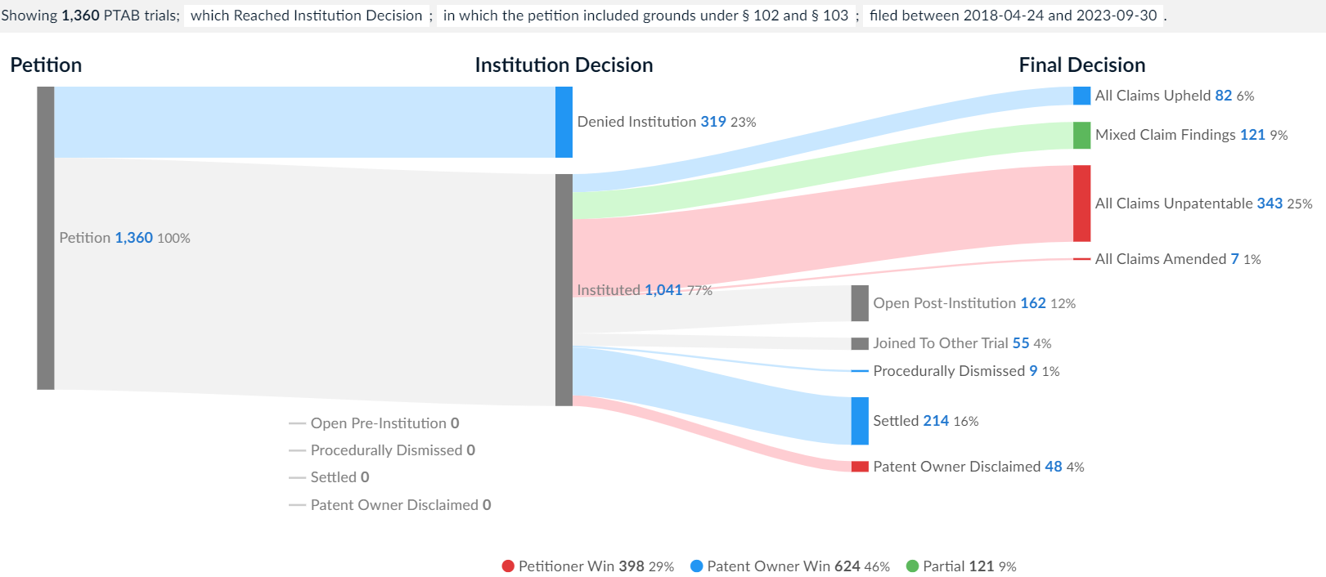
Selecting Grounds for the Petition
Petitions including both § 102 and § 103 grounds: 1,360 petitions
Criteria:
Post-SAS filing date
Reached institution Decision
Includes 102 and 103 grounds
Source: Lex Machina

Slide 7
Selecting Grounds for the Petition
Just 43 petitions relied on anticipation grounds alone
74% instituted; 33% overall win rate (disclaimer or all claims unpatentable)
3,654 petitions relied on obviousness grounds alone
71% instituted; 25% overall win rate (disclaimer or all claims unpatentable)
1,360 petitions relied on both anticipation and obviousness grounds
77% instituted; 29% overall win rate (disclaimer or all claims unpatentable)
Observations:
Only 28% of petitions relied on anticipation grounds (either alone or in combination with obviousness); give higher institution rates
Anticipatory references are hard to find and/or petitioners are nervous about alleging anticipation

Slide 8
Anticipation
Anticipation is an exacting standard
Net MoneyIN, Inc. v. VersiSign, Inc., 545 F.3d 1359 (Fed. Cir. 2008)
A showing of anticipation requires:
“all elements of the claim within the four corners of the document”
“arranged or combined in the same way as in the claim”
“without any need for picking, choosing, and combining various disclosures not directly related to each other by the teachings of the cited reference.”

Slide 9
Anticipation
Anticipation is an exacting standard
Net MoneyIN, Inc. v. VersiSign, Inc., 545 F.3d 1359 (Fed. Cir. 2008)
Net MoneyIN has been cited by the PTAB in:
227 Institution Decisions (institution denied)
155 Final Written Decisions (claims not unpatentable)

Slide 10
Anticipation
Anticipation is an exacting standard
Microsoft Corp. v. Biscotti, Inc., 878 F.3d 1052 (Fed. Cir. 2017)
Microsoft appealed three IPRs that held claims not unpatentable
Federal Circuit recognizes some wiggle room on anticipation:
“a claim does not need to ‘expressly spell out’ all limitations combined as in the claim if a POSA would ‘at once envisage’ the arrangement or combination.”
Ultimately, Federal Circuit affirmed the Board decision of no anticipation
Anticipation is a factual question reviewed for substantial evidence
Majority called it a “close question”
Federal Circuit decision included a dissent (Judge Newman)
IPR decisions included a dissent

Slide 11
Single-Reference Obviousness
Solution: Rely on anticipation AND single-reference obviousness
Post-SAS, partial institution is not a concern
Don’t need to worry whether the Board will select your anticipation ground over your single-reference obviousness ground, or vice versus
Draft the anticipation ground first
Add a shorter obviousness ground
“Even if…”
Add motivation and reasonable expectation of success
Support it with an expert declaration
But are you just highlighting a weakness in your primary reference???

Slide 12
Single-Reference Obviousness
Remember! Single-reference obviousness may require a motivation
In re Stepan Co., 868 F.3d 1342, 1346 n. 1 (Fed. Cir. 2017)
“Whether a rejection is based on combining disclosures from multiple references, combining multiple embodiments from a single reference, or selecting from large lists of elements in a single reference, there must be a motivation to make the combination and a reasonable expectation that such a combination would be successful, otherwise a skilled artisan would not arrive at the claimed combination.”
Limited exceptions:
Boston Sci. Scimed, Inc. v. Cordis Corp., 554 F.3d 982, 991 (Fed. Cir. 2009)
Realtime Data v. Iancu, 912 F.3d 1368, 1373 (Fed. Cir. 2019)

Slide 13
Single-Reference Obviousness
In limited circumstances, common sense can supply a “known motivation” in cases of single-reference obviousness
Arendi S.A.R.L. v. Apple Inc., 832 F.3d 1355, 1361 (Fed. Cir. 2016)
“[C]ommon sense and common knowledge have their proper place in the obviousness inquiry,” at least “if explained with sufficient reasoning.”

Slide 14
Single-Reference Obviousness
How has the Board treated anticipation + single-reference obviousness?
Some panels have addressed both routes
Pacific Surf Designs, Inc. v. Surf Waves, Ltd., Case No. IPR2016-01454 (Paper 31)
“Although the Petition presents single-reference obviousness arguments intertwined with anticipation arguments, we consider them two separate grounds and evaluate them separately.”
Palette Life Sci., Inc. v. Incept LLC, Case No. IPR2020-00002 (Paper 62)
“Even if Wallace were to be viewed as not teaching each claim limitation, we agree with Petitioner that based on the current record and persuasive testimony of [experts], Wallace would have suggested to a person of ordinary skill in the art to select and prepare a biocompatible, biodegradable polymer gel….”

Slide 15
Single-Reference Obviousness
How has the Board treated anticipation + single-reference obviousness?
Some panels have addressed anticipation and punted on obviousness
CoolIT Systems, Inc. v. Asetek Danmark A/S, Case No. IPR2020-00522 (Paper 40)
“[A]ddressing Petitioner’s single reference obviousness ground would not change our conclusion that these claims are unpatentable (see supra 17–23), and we thus decline to consider this ground. See, e.g., Bos. Sci. Scimed, Inc. v. Cook Grp. Inc., 809 F. App’x 984, 990 (Fed. Cir. 2020) (nonprecedential) (rejecting argument that it is improper for the Board to decline to address alternative grounds with respect to claims found unpatentable on another ground, and determining that ‘the Board need not address issues that are not necessary to the resolution of the proceeding’)”

Slide 16
Single-Reference Obviousness
How has the Board treated anticipation + single-reference obviousness?
Some panels have addressed obviousness and punted on anticipation
Spectrum Solutions LLC v. Longhorn Vaccines & Diagnostics, LLC, Case No. IPR2021-00847 (Paper 112)
“Having determined that Petitioner has shown these claims would have been obvious over Birnboim, we do not address the anticipation ground. See SAS Inst. Inc. v. Iancu, 138 S. Ct. 1348, 1359 (2018) (holding a petitioner “is entitled to a final written decision addressing all of the claims it has challenged”); Bos. Sci. Scimed, Inc. v. Cook Grp. Inc., 809 F. App’x 984, 990 (Fed. Cir. 2020) (recognizing that the “Board need not address issues that are not necessary to the resolution of the proceeding” and, thus, agreeing that the Board has “discretion to decline to decide additional instituted grounds once the petitioner has prevailed on all its challenged claims”).

Slide 17
Addressing Analogous Art Arguments
Do you need to establish up front in the petition that references are analogous art for obviousness purposes?
In the past, Board panels have denied institution because the petition itself did not address whether two references are analogous art for obviousness purposes
Chamberlain Group, LLC v. Overhead Door Corp. Case No. IPR2022-00842 (Paper 9).
“Petitioner does not address whether [the reference] is analogous art,” thus, the Board held that “Petitioner does not sufficiently show that [the reference] would logically have commended itself to an inventor’s attention in considering a problem of” of the challenged patent.

Slide 18
Addressing Analogous Art Arguments
Does the petition itself need to establish that references are analogous art for obviousness purposes?
Federal Circuit: No. A petitioner can address it on reply
“A petitioner is not required to anticipate and raise analogous art arguments in its petition; instead a petitioner can use its reply to ‘respond to arguments raised in the corresponding opposition, patent owner preliminary response, patent owner response, or decision on institution.’”
-- Sanofi-Aventis Deutschland GmbH v. Mylan Pharms. Inc., 66 F.4th 1373, 1379 (Fed. Cir. 2023) ( citing 37 C.F.R. § 42.23)

Slide 19
Addressing Analogous Art Arguments
In an analogous art analysis, do you compare the prior art references to each other or to the challenged patent?
Federal Circuit: comparison is to the challenged patent
“In evaluating whether a reference is analogous, we have consistently held that a patent challenger must compare the reference to the challenged patent.”
-- Sanofi-Aventis Deutschland GmbH v. Mylan Pharms. Inc., 66 F.4th 1373, 1377 (Fed. Cir. 2023)
“Because Mylan argued that de Gennes is analogous to another prior art reference and not the challenged patent, Mylan did not meet its burden to establish obviousness premised on de Gennes and the Board's factual findings regarding analogousness are not supported by substantial evidence.”
-- Id. at 1374.

Slide 20
Claim Construction Issues With Prior and Parallel Proceedings

Slide 21
Claim Construction Issues With Prior and Parallel Proceedings
Options for addressing prior decisions of a District Court, the ITC, the PTAB, or the Federal Circuit
Options for addressing parallel district court claim construction proceedings

Slide 22
PTAB Guidance on District Court / ITC Constructions
The PTAB is NOT bound by any district court or ITC decision
BUT
The PTAB will consider prior constructions from district courts or ITC
37 C.F.R. § 42.100(b)

Slide 23
PTAB Consideration of District Court / ITC Construction
Non-Exclusive Factors
How thoroughly reasoned the prior decision is;
The similarities between the record;
Whether the prior claim construction is final or interlocutory;
Whether the terms construed by the district court / ITC are necessary to decide the issues before the PTAB.
83 Fed. Reg. 51,355

Slide 24
Near Fait Acompli Adoption of the District Court Construction
No challenge to a prior construction or a different proposed construction; and
Evidence of the prior construction is in the record
Examples:
Google LLC v. Uniloc 2017 LLC, IPR2020-00479, Paper 24 at 9-11 (PTAB July 22, 2021)
- PTAB adopted numerous district court constructions without analysis
3Shape A/S v. Align Tech., Inc., IPR2020-00223, Paper 35 at 17-19 (PTAB April 22, 2021)
- PTAB adopted multiple ITC constructions without analysis

Slide 25
When Proposed Construction Differs from District Court / ITC
“Minimizing differences between claim construction standards used in the various for a will lead to greater uniformity and predictability of the patent grant, improving the integrity of the patent system.”
83 Fed. Reg. 51,340, 51,342 (Oct. 11, 2018)
“If we were to adopt Petitioner’s claim construction as presented in the Petition, and if the district court were to adopt Petitioner’s claim constructions as proposed there, the subsequent decisions issued in reliance on these inconsistent claim constructions may lack ‘uniformity’ between us and the district court and may undermine the ‘predictability’ of the ’296 patent’s claim scope and the ‘integrity of the patent system.’ overall.”
Kiosoft Techs. LLC v. Payrange, Inc., IPR2021-00086, Paper 12 at 15-16 (PTAB Mar. 22, 2021)

Slide 26
Potential Strategy 1: Address Prior Constructions Head On
“Having made the ALJ’s constructions of record here, Petitioner needs to explain why we should depart from those constructions to identify satisfactorily ‘how the challenged claim is to be construed.’”
“Petitioner’s claim construction approach asks us to accept its claim constructions (without any supporting reasoning as to why these constructions are proper) and eschew the ALJ’s constructions, which she developed applying the same claim construction standard we apply, and after the parties fully briefed the issues. We are reluctant merely to accept constructions at odds with the ALJ’s constructions without any supporting analysis from Petitioner.”
3Shape A/S v. Align Tech., Inc., IPR2020-00222, Paper 12 at 14 (PTAB May 26, 2020)

Slide 27
Potential Strategy 2: Your Construction Is Consistent With Prior Construction
It may be possible to obtain an altered construction that remains consistent with the prior construction.
Juniper Networks, Inc. v. Packet Intel. LLC, IPR2020-00486, Paper 20 at 27-30 (PTAB Sept. 10, 2020) (removing phrases from the prior PTAB and district court construction that the PTAB viewed as non-limiting examples)

Slide 28
Potential Strategy 3: If Your Construction Differs, Lean on PTAB’s Factors
Failure of the district court to explain its construction
Micron Tech., Inc. v. Good Kaisha IP Bridge 1, IPR2020-1007, Paper 19 at 10, n.4 (PTAB Feb. 2, 2021) (“the Texas court has not provided any opinion, reasoning, or explanation supporting those constructions.”)
Critical flaws in prior construction
Renesas Elecs. Corp. v. Broadcom Corp., IPR2019-01040, Paper 35 at 13-18 (PTAB Nov. 13, 2019) (declining to adopt an ITC construction that created redundancies in the claim and excluded the preferred embodiment).
Major distinctions in the records
Google LLC v. Virentem Ventures, LLC, IPR 2019-01247, Paper 34 at 10-12 (PTAB Mar. 5, 2021) (“we construe the term ‘presentation rate’ differently than the District Court, because the records in the District Court case and in this proceeding relating to construction of ‘presentation rate’ are different.”)

Slide 29
Potential Strategy 4: Further Explanation of Plain and Ordinary Meaning
If the District Court / ITC construes as term as “plain and ordinary meaning” without explanation, may be possible to obtain further explanation at the PTAB
Micron Tech., Inc. v. Unification Techs. LLC, IPR2021-00345, Paper 41 at 12-14 (PTAB July 15, 2022) (“[W]e agree with the district court that the term … has its ordinary and customary meaning. However, it remains for us to determine what a person of ordinary skill in the art would consider to be the term’s ordinary and customary meaning, in light of the patent disclosure.”)

Slide 30
When the Federal Circuit Has Weighed In
Prior constructions will likely be much more difficult to overcome
Ford Motor Co. v. Mass. Inst. of Tech., IPR2021-00341, Paper 10 at 24-25 (PTAB July 2, 2021)
Federal Circuit had previously affirmed district court construction of a term in the parallel litigation
“We do not agree with Petitioner that we need not construe the … terms because the construction is not in dispute in this proceeding … [T]he construction is … dispositive of the grounds presented in the Petition.”
“We are compelled to construe the terms consistent with the claim construction afforded by the district court and … affirmed by the Federal Circuit”
However, the PTAB noted:
- “[W]e are not saying that a petitioner cannot put forth a construction in a petition that is contrary to its claim construction position in a parallel litigation…”

Slide 31
Parallel District Court Proceedings
Scenario
In district court, Patent Owner has implicitly taken a very broad view of its claims through infringement contentions;
You think Patent Owner’s implicit constructions are wrong, but under them, you have a strong prior art challenge.
What are your options?

Slide 32
Option 1: Press Your Construction in Both Forums
Pros:
You stay consistent in your position
PTAB or District Court adopting your construction may effectively be a win on non-infringement
Cons:
May not be able to use the art that is strong under PO’s construction
Very likely to have a major claim construction argument as part of the petition
Other Considerations:
If there is no stay in the District Court, potential for inconsistent results
PTAB likely will not have the context for why the claim construction dispute matters
Potentially puts the resolution of claim construction entirely within the PTAB’s hands

Slide 33
Option 2: Proceed in PTAB Under PO’s Implicit Construction
Pros:
Proceed under the art you perceive to be strong under PO’s construction
PO unlikely to argue the construction is wrong
Cons:
PO will criticize you for being inconsistent in your positions
Potential that PTAB agrees with PO’s construction, foreclosing your non-infringement defense
Other Considerations:
Potential foreclosure of indefiniteness challenges
If you have the same expert in PTAB and District Court, potentially makes them apply inconsistent positions
Compliance with 37 C.F.R. § 42.104(b)(3)

Slide 34
Rule 42.104(b)(3) Considerations
“Identification of challenge. Provide a statement of the precise relief requested for each claim challenged. The statement must identify the following: … (3) How the challenged claim is to be construed.”
PTAB Views on Whether Proceeding Under a Construction You Disagree With Have Shifted
Some early PTAB decisions required petitioners to express agreement with the proposed construction
E.g., Toyota Motor Corp. v. Blitzsafe Tex., LLC, IPR2016-00422, Paper 12 (PTAB July 6, 2016)
More recent decisions indicate, you can disagree, but can’t say so
E.g., Western Digital Corp. v. SPEX Tech. Inc., IPR2018-00084, Paper 14 (PTAB April 25, 2018)
Other recent decisions indicate expressing disagreement still complies with Rule 42.104(b)(3) in some circumstances
10X Genomics, Inc. v. Bio-Rad Labs., IPR2020-00086, Paper 8 (PTAB April 27, 2020)

Slide 35
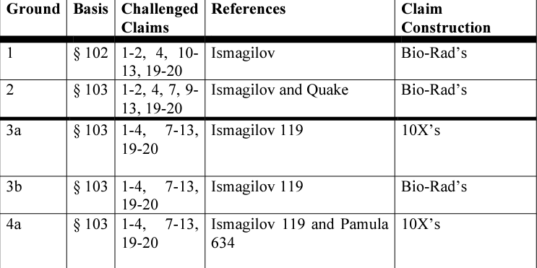
10X Genomics, Inc. v. Bio-Rad Labs.
The Petition stated:
10X challenges Bio-Rad’s claims under two main theories. First, 10X identifies prior art disclosures meeting the broad constructions implied by Bio-Rad’s infringement contentions … Second, under 10X’s proposed constructions….”
The Institution Decision:
Found this approach complies with Rule 42.104(b)(3): “Because the Petition expressly sets forth [PO’s] expected interpretations as Petitioner’s proposed alternative constructions…”
The Rules permit alternative constructions. 77 Fed. Reg. 48,700

Slide 36
Option 3: Propose Grounds Under Alternative Constructions
Pros:
Allows you to straddle the line to some extent
Can put patent owner in a difficult position
Can allow you to preserve your positions in District Court
Cons:
Requires waiting to have a solid understanding of PO’s constructions
Can only do this if you have art under both constructions
Compliance with Rule 42.104(b)(3) is not completely settled
Other Considerations:
Recognize that one of your grounds is almost certain to be rejected in a final written decision
Interplay with district court proceeding
Word count issues
Expert testimony issues

Slide 37
Thank you!
Ben Anger
ben.anger@knobbe.com
Brandon Smith
brandon.smith@knobbe.com

